Slide 1
How to loop up RAM?

Slide 2
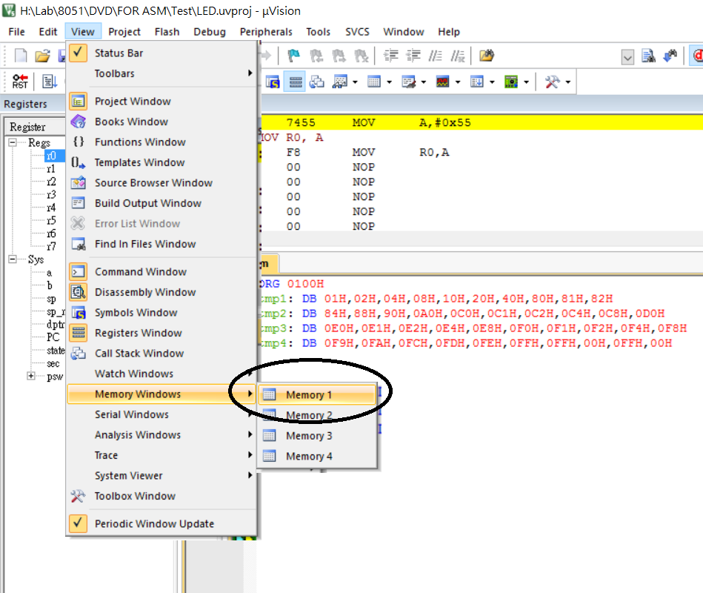
1. Start debugging 2. Open one memory window

Slide 3
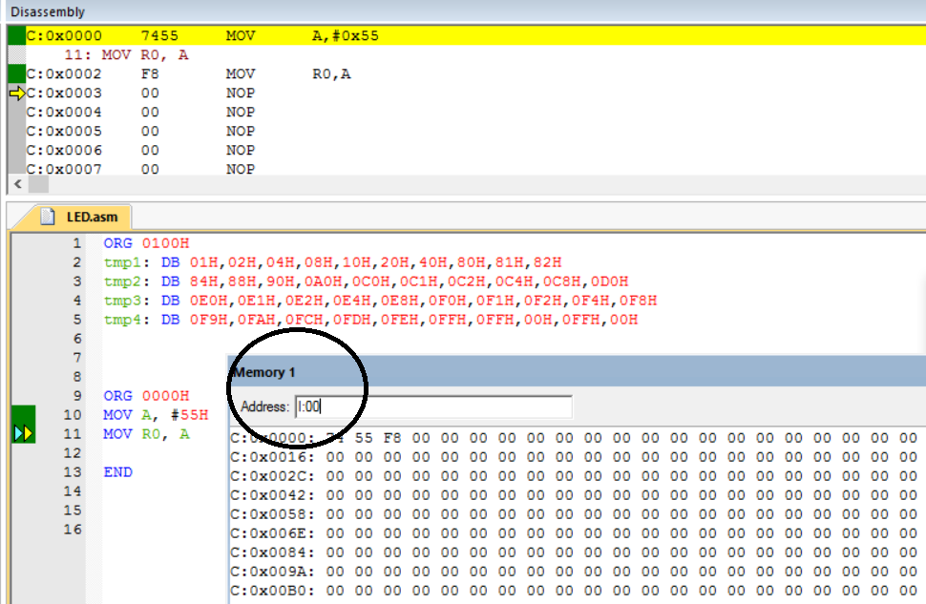
3. Input I:00

Slide 4
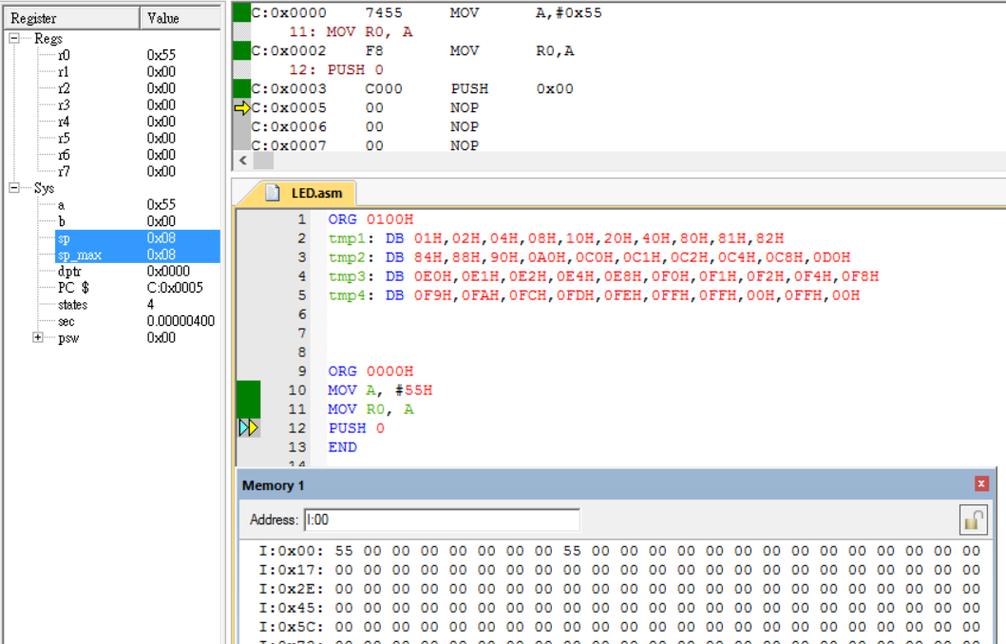
And sp is increased by 1
You can see 55 (in R0) is pushed in stack

